Slide 1
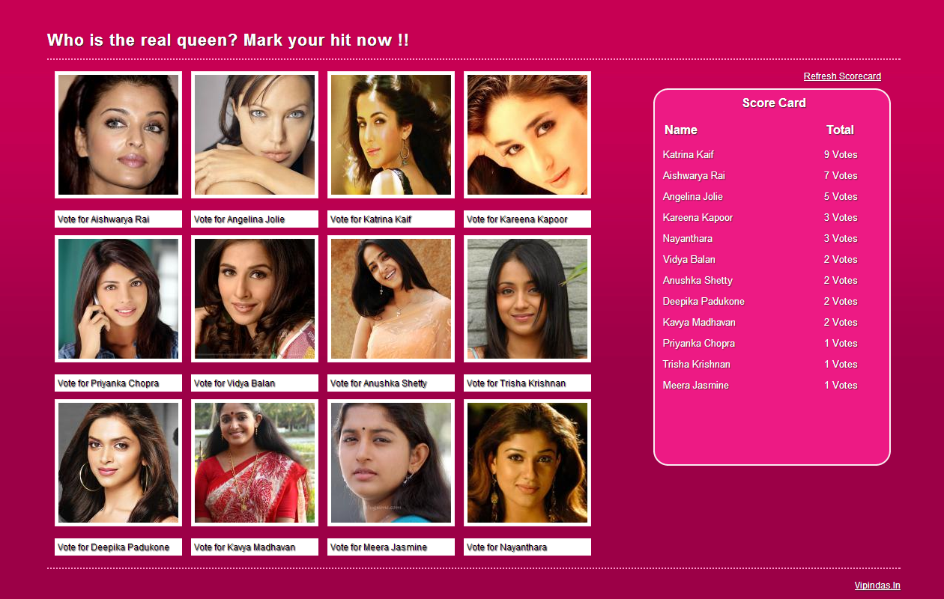
Home Page

Slide 2
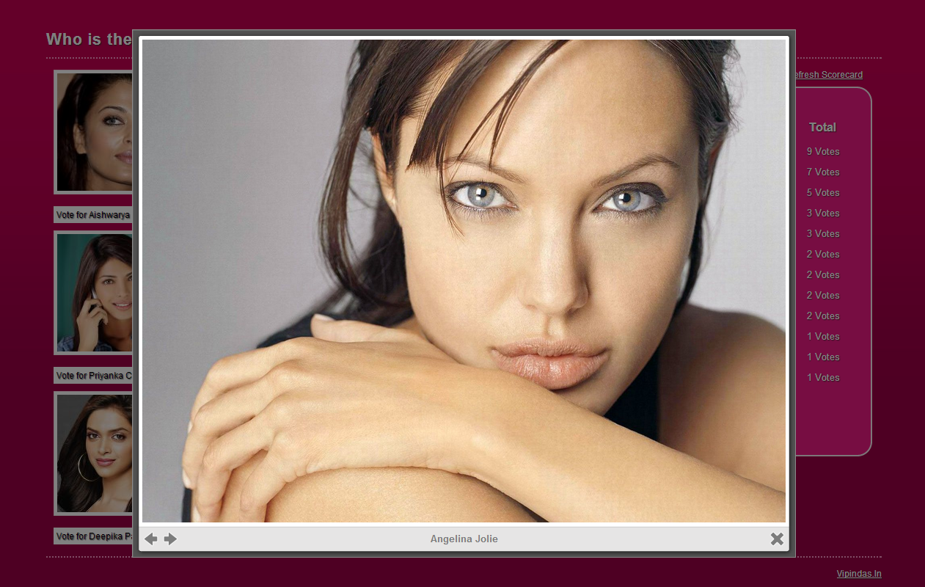
CLICK ON PHOTO TO ZOOM

Slide 3
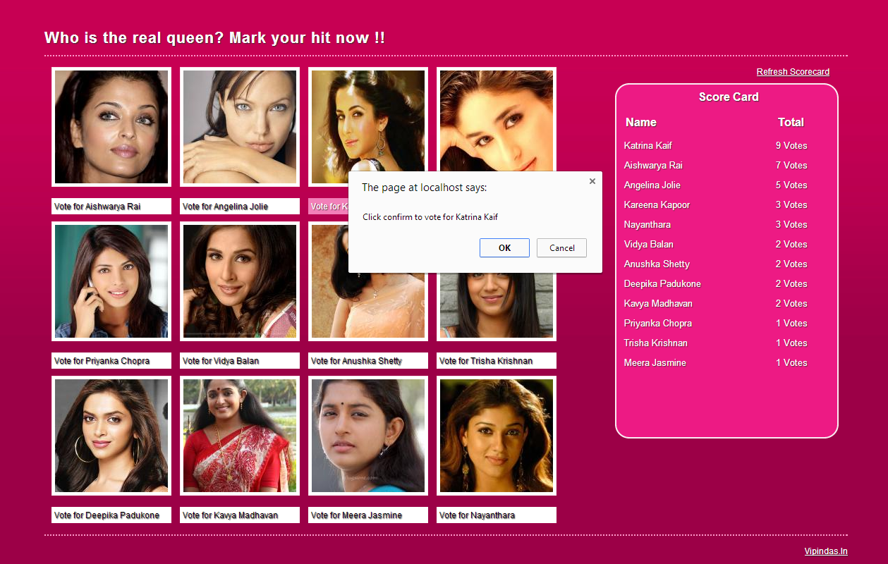
CLICK ON VOTE AND VIEW SCORE CARD

